Slide 1

Adaptive Urban Guide
See.Adapt.Navigate
Jairam Reddy, Abhay Mulgund, Sree Kuntamukkala
February 07, 2026
Notes:
abhay

Slide 2
Target Customer/Segment
Primary: Urban navigators with Vision Impairment (Blind/ Low Vision) requiring high autonomy tools
Focus: Provides real time hazard avoidance in dense city places
Why Now:
The “Smart City” Safety gap: environments becoming denser and more chaotic
Democratizing Assistive Tech: costly hardware
The Maturity of Edge Intelligence: we can run "Vision-to-Action" directly in mobile with zero server lag
Page #
Notes:
abhay

Slide 3
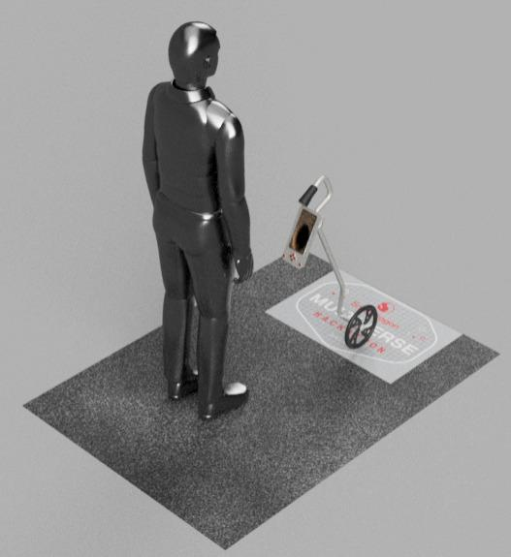
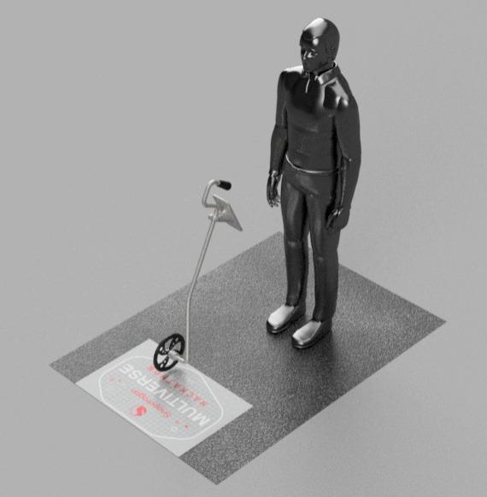
The Product - Urban Guide
CAD Model of The Urban Guide Product
Notes:
abhay

Slide 4
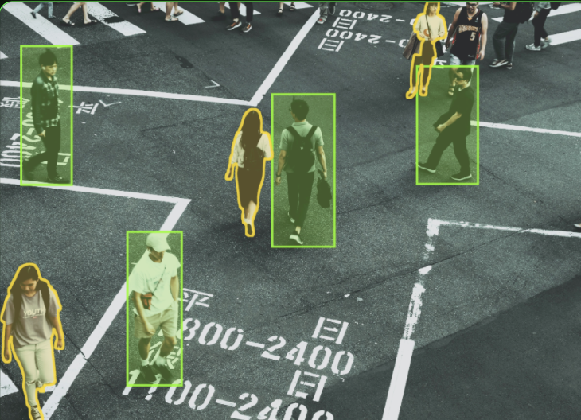
The Perception Layer
Before the system makes a decision, it must “see” and “label” the environment
COCO-SSD Model: MultiBox Detector to identify 80+ classes
WebGL Acceleration: Direct GPU access for high speed inference
Dynamic Bounding: Calculates spatial coordinates in real time
Notes:
Now, let’s look at the first step in our pipeline: Perception. For our users, the system must act as a digital set of eyes. To achieve this, we integrated the COCO-SSD model, a powerful MultiBox detector capable of identifying over 80 different classes of urban objects—from cars and traffic lights to pedestrians and stairs.
However, identification is only part of the challenge. In a safety-critical application, every millisecond counts. This is why we implemented WebGL Acceleration. By tapping directly into the device’s GPU, we achieve high-speed inference that bypasses the cloud entirely. This means the system provides zero-latency feedback, which is vital because a car moving at city speeds doesn't wait for a server to respond. Our dynamic bounding logic ensures we are calculating spatial coordinates in the user's frame of reference, in real-time, every single frame.

Slide 5
The RL State Vector
The “brain” of the app does not just see the object, it translates the object to a mathematical State Vector.
Distance Proxy: Calculated by the object’s area
Deviation (x): Measures how far the object is from the center of the user's path.
Velocity (v): Calculated by the rate of change in the object's size over time
Class Weighting: A 'Stop Sign' carries different priority than a 'Bottle' in the path.
Notes:
Once the system 'sees' an object, it needs to understand the intent and danger of that object. Raw pixels are useless to an AI, so we translate the bounding box into a four-dimensional State Vector.
This vector is the mathematical 'brain' of the app. We look at:
Distance Proxy: Since we are using a 2D camera, we use the object's Area as a proxy for distance—the larger the area, the closer the threat.
Deviation (x): This measures how far an object is from the center of the user's path.
Velocity (v): We calculate the rate of change in the object's size. If an object is growing rapidly in the frame, our AI recognizes it as an approaching hazard.
Class Weighting: Finally, we assign priority. A moving bus carries a significantly higher weight in our risk calculation than a discarded bottle on the sidewalk. This vector allows us to move from 'seeing' to 'reasoning'

Slide 6
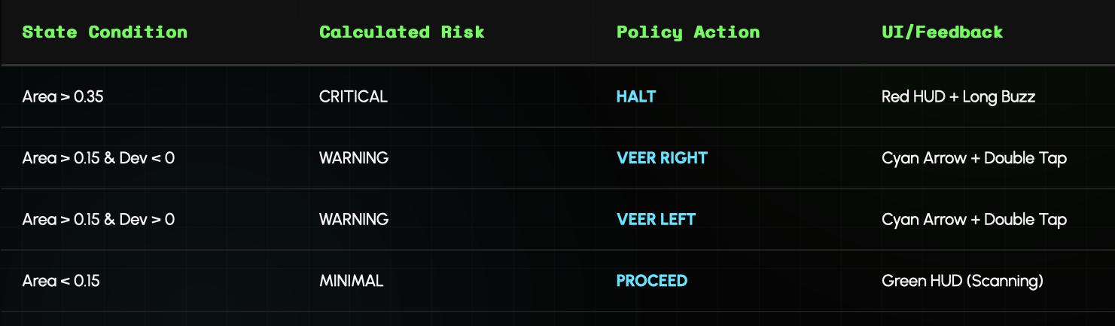
The Decision Policy
Once the state vector is defined, the Policy executes an action.
Logic that decides whether the user is safe or needs to move:
Notes:
With the State Vector defined, our Reinforcement Learning Policy takes over to execute an action. This is the logic that decides whether a user is safe or needs to move immediately.
As you can see in our policy matrix, we’ve defined clear risk thresholds. If the Area exceeds 0.35, the system identifies a CRITICAL risk and triggers a HALT command. If the object is closer but off-center, the policy triggers a VEERcommand—directing the user to the left or right to avoid the obstacle.
What makes this 'Adaptive' is the Policy Optimizer. We use a reward function—R=Area×(1−∣Dev∣)—which effectively punishes the system if it allows a large object to remain in the user's central path. This closed-loop system ensures that the guidance provided is always the mathematically 'safest' path through a chaotic urban environment."

Slide 7
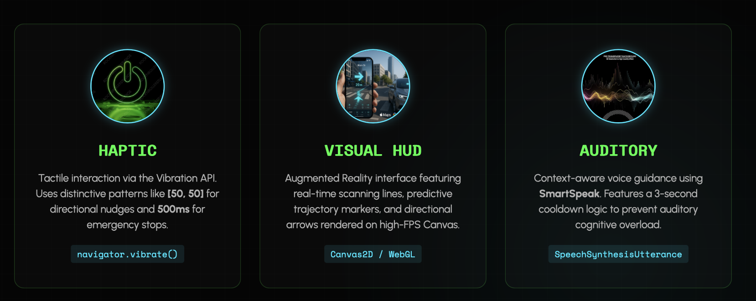
Multi-modal Feedback
Notes:
jairam

Slide 8
User Centric Calibration
The system isn't "one size fits all." Through the Training Controller, RL weights are tuned for individual mobility and hardware performance.
Safety Buffer: Allows users with slower mobility to increase sensitivity, triggering early "HALT" commands and expanding the spatial risk perimeter.
Latency Compensation: adjusts the AI's "reaction window"
Profile Optimization: personalized "Reward Weights" that prioritize specific environmental classes (stairs vs. vehicles)
Notes:
jai

Slide 9
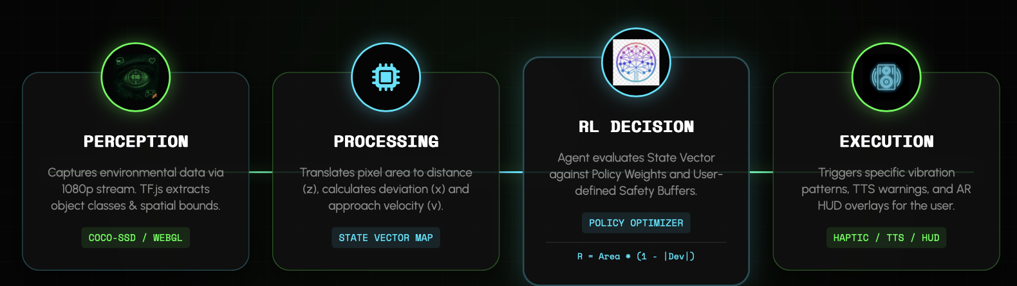
System Intelligence Flow
Notes:
jai

Slide 10
Elevator Pitch
Adaptive Urban Guide, an edge-AI navigation system that turns every smartphone into a reactive sensory shield for the visually impaired. By combining real-time computer vision with on-device reinforcement learning, our app detects hazards and provides personalized, multimodal feedback: haptic, auditory, and visual to help users navigate complex city environments with confidence. It’s private, zero-latency, and adapts its safety logic to every individual's unique mobility needs.
Notes:
abhay

Slide 11
Thank You!

